Slide 1
Distance Learning for Legal Education:
Pedagogical Considerations &
Best Practice Recommendations.
“The Road Travelled & The Journey Yet Ahead”
William Byrnes
University of Arizona College of Law
Faculty Enrichment Presentation
April 9 (Thursday)

Slide 2
Why is this discussion interesting?
  May expand the universe of pedagogical techniques for the legal educator’s toolkit
  Exposure to other teaching methods and technologies
  Understand overlap of neuro-science, learning psychology & cognition
  Examples of outcome based course designs

Slide 3
Who is doing it?
  48 online LL.M.s by 30 ABA law schools
  Hybrid JD by William Mitchell-Hamline
  See National Jurist February 2015 list

Slide 4
Is it Legit?
“On average, students in online learning conditions performed better than those receiving face-to-face instruction.”
2009 U.S. Department of Education’s Evaluation of Evidence-Based Practices in Online Learning--A Meta-Analysis and Review of Online Learning Studies of the period 1996 through 2008 of university, graduate and professional studies, e.g. medical, technology, engineering and law

Slide 5

Are Experts Born or Made?
Neuro Science
Learning Psychology
& Online Pedagogy

Slide 6
  “Diverse groups of problems solvers
  – groups of people with diverse tools –
  consistently outperform groups of the best & the brightest”
  = Perspectives & Collaboration

Slide 7
New Skills – New Learning*
knowledge management
(superior information gathering and discernment)
techno-social skills
(group work skill set)
*Berkman Center (Harvard) Study (Koo)

Slide 8
“Experts are made – not born”
How Long Does it Take?
What Does it Take?
Can We Make the Process More Efficient?

Slide 9
Technician v. Professional
Learn to Identically Repeat a Set of Tasks to Create a Result
Obtain a Body of Knowledge & Able to Apply to Changing Facts

Slide 10
Leveraging Distance Education
  Communications Technology: Oral Tradition, to Codex, to Internet
  Best Practices (See Distance Education Work Group)

Slide 11
How Information is researched and analyzed
  Structure of law and legal analysis
  Working knowledge of resources available
  Identify appropriate sources of law

Slide 12
New Generation of Legal Research -How Information is researched and analyzed
  Access of Legal Information expands or contracts the universe of perspectives and potential solutions
  Crowd Sourcing, Concept Mapping, Algorithms, & Artificial Intelligence

Slide 13
How Information is researched and analyzed
  New Legal Research Platforms are emulating Google which is “Crowd Sourcing”
  Algorithms that track meaningful interactions with documents by all users of platform with results
  Examples: WestNext & Lexis Advance search 40,000 databases, over 1 billion documents

Slide 14
Course Development
  Law & Linguistics (linguistics in the context of language, as well as in the context of semiotics)
  Contextualization: historical, sociological, economic

Slide 15
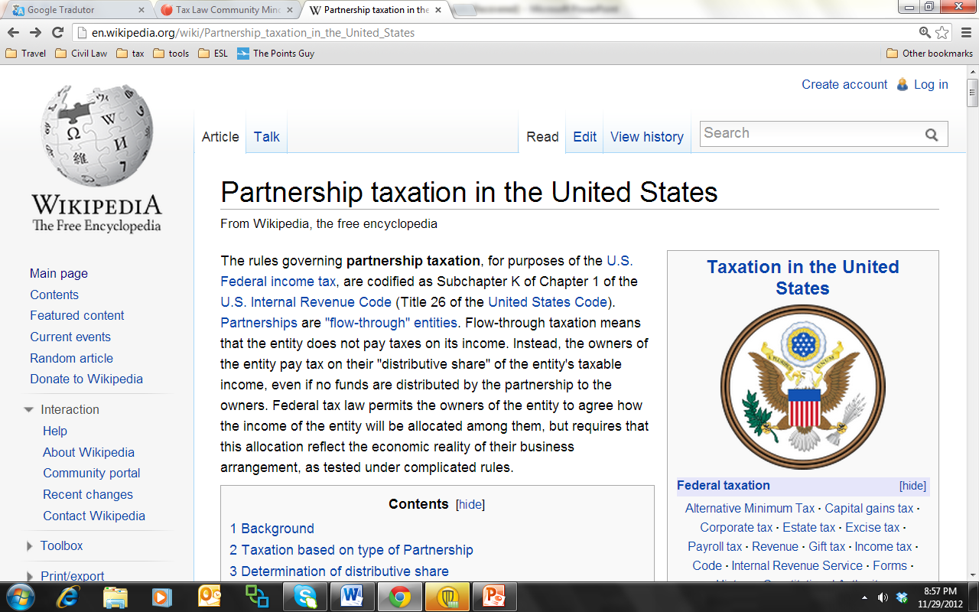

Slide 16
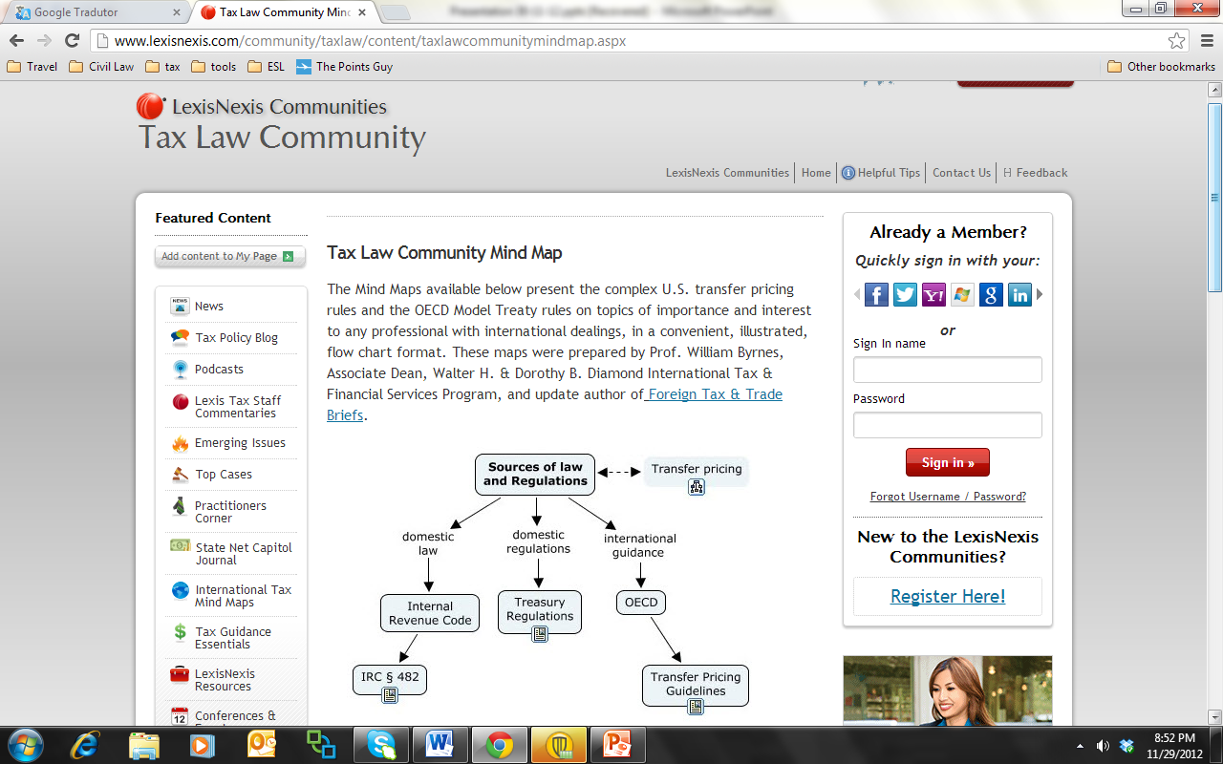

Slide 17
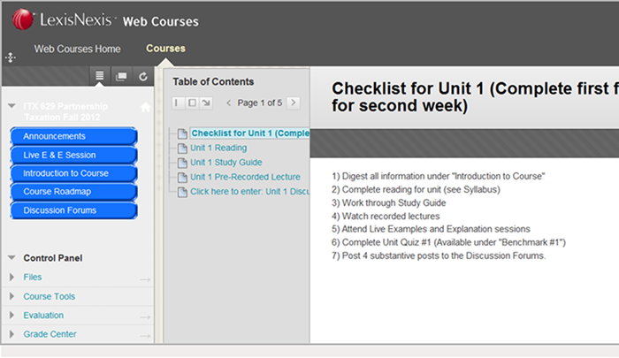

Slide 18
“Through the eye of a needle”
Cognitive Limit: 4 slots of active memory
Slot is active for 20 seconds absent long term memory acquisition techniques

Slide 19
Efficient Use of Limited Resource
Cognitive Protocols →
Efficient Learning

Slide 20
“It’s all in the packaging”
Learning Frameworks
  Schema
  Matrices
  Mind-mapping

Slide 21
Memory Protocols
Chunking
Schematic
Hierarchical
Subjective organization
Encoding versus retrieval
Shallow versus deep
Cuing and cue-dependant learning

Slide 22
Recommendations
Definitions
Standard 1. BEST PRACTICES: RESOURCES FOR PROVISION OF STUDENT SERVICES
Standard 2. BEST PRACTICES: ACCESS TO INFORMATION
Standard 3. BEST PRACTICES: REGISTRATION FOR DISTANCE LEARNING STUDENTS
Standard 4. FINANCIAL AID, BILLING AND ACCOUNTING
Standard 5. CAREER COUNSELING AND PLACEMENT SERVICES
Standard 6. SCHEDULING
Standard 7. ALUMNI RELATIONS
Standard 8. ACCESSIBILITY
Standard 9. ACADEMIC SUPPORT AND STUDENT ENGAGEMENT
Standard 10. TECHNOLOGY AND STUDENT ENGAGEMENT

Slide 23
Chapter 1
Delivery Methods and Practices
Delivery Models: Synchronous Model
Delivery Models: Asynchronous Model
Strengths of asynchronous online education
Considerations
Cost of platform and instruction
Staffing teams
Technology
Access
Pedagogy
Hybrid systems

Slide 24
Chapter 2
Challenges, Solutions, Best Practices
Webcasts
Site-to-site
Closed Broadcast
Open Broadcast
Visual Two-way vs. Visual One-way
Audio Two-way vs. Visual One-way

Slide 25
Chapter 2
Challenges, Solutions, Best Practices
Live Dialog (aka “Chats”)
Video
Audio
Text
Voice-to-text

Slide 26
Contact William Byrnes?
  Prof. William Byrnes
  williambyrnes@gmail.com
  +1 (786) 271-5202
  www.linkedin.com/in/williambyrnes/

